Slide 1
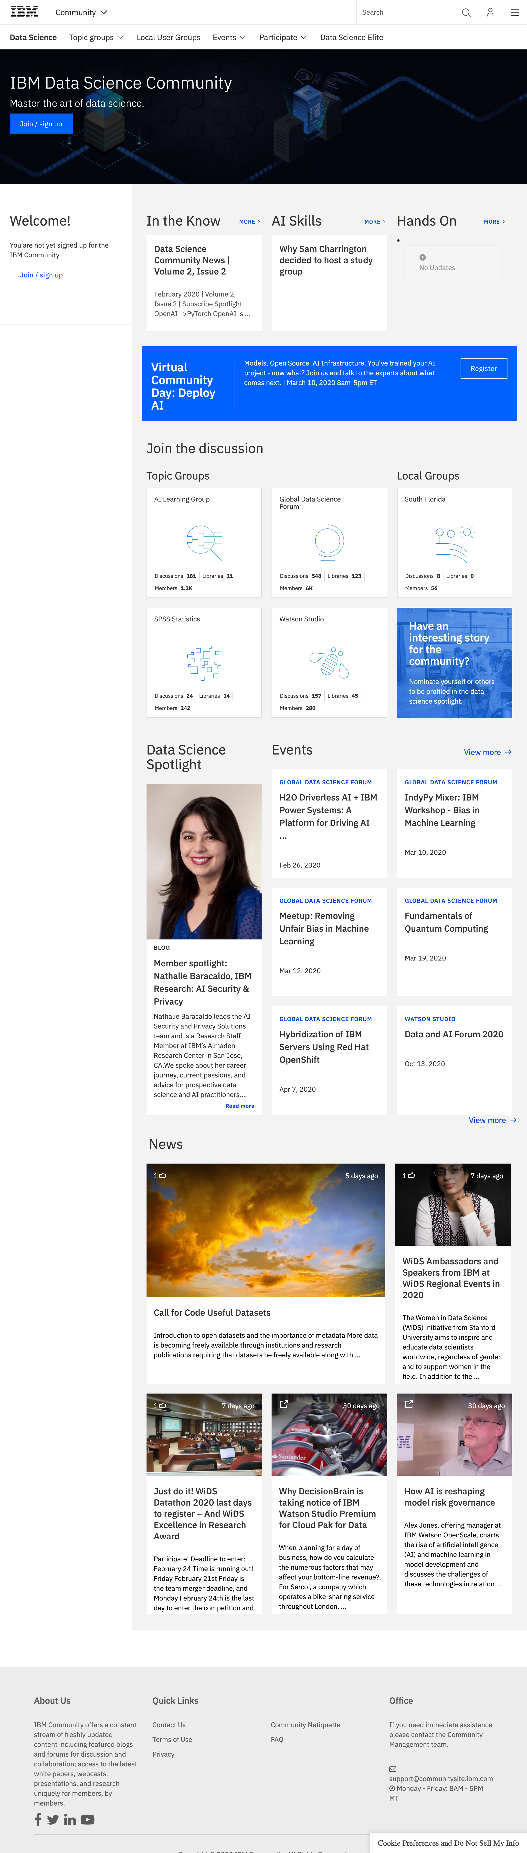
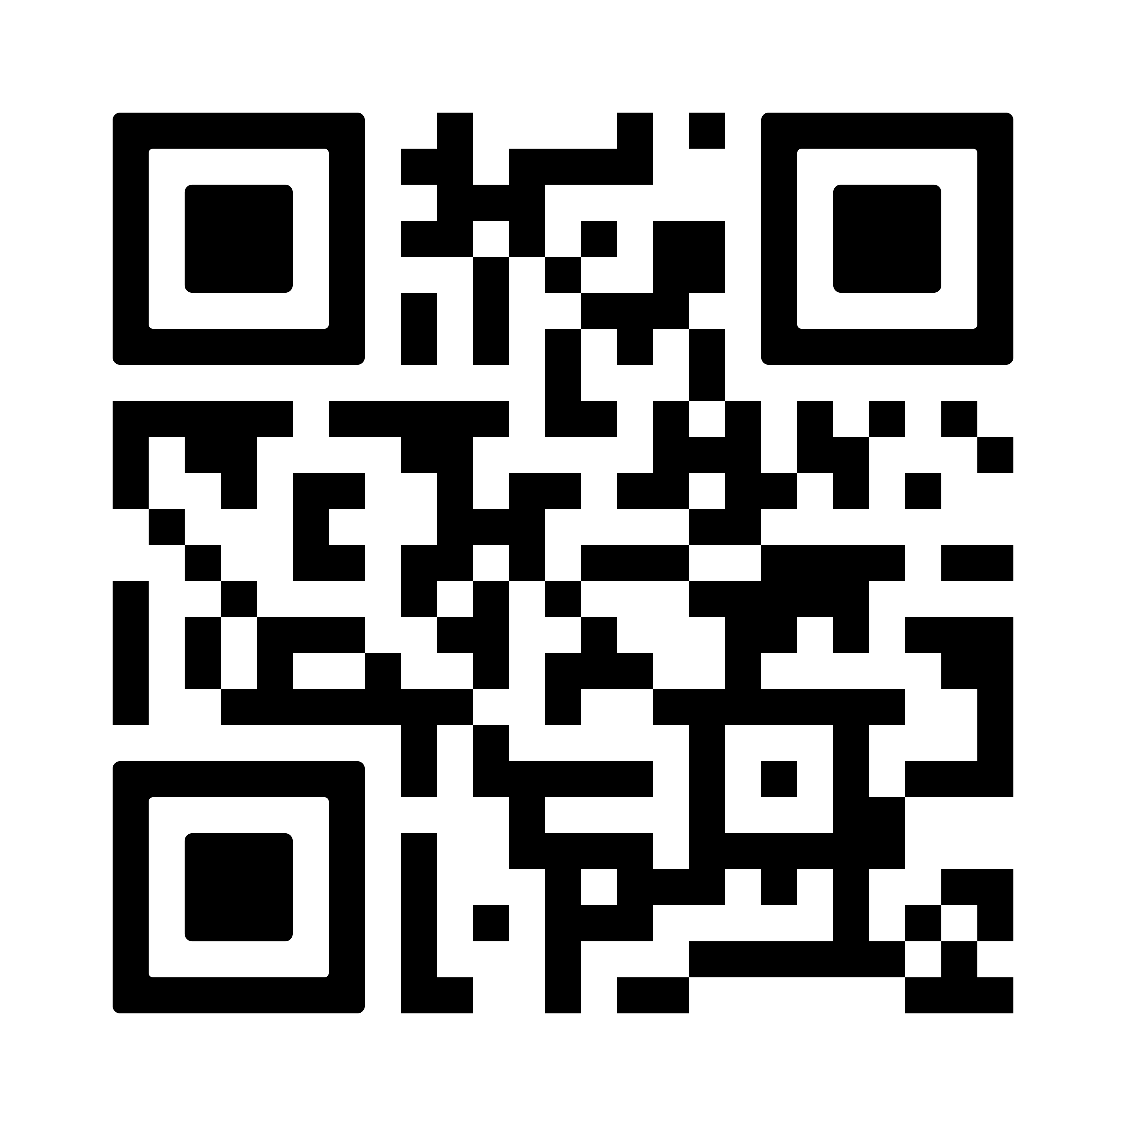
zSpecial Offer: IBM & Coursera
Join the
IBM Data Science Community
and get a complimentary month of select IBM Data Science & AI Specialization Programs on Coursera
Learn Resources galore & experts on tap (just ask)
Share 6,000+ members and counting!
Engage Post blogs, start
forum discussions, join webinars, online hackathons
& events
http://ibm.biz/community-coursera

